Slide 1
Aspirations
Kevin Stannard

Slide 2
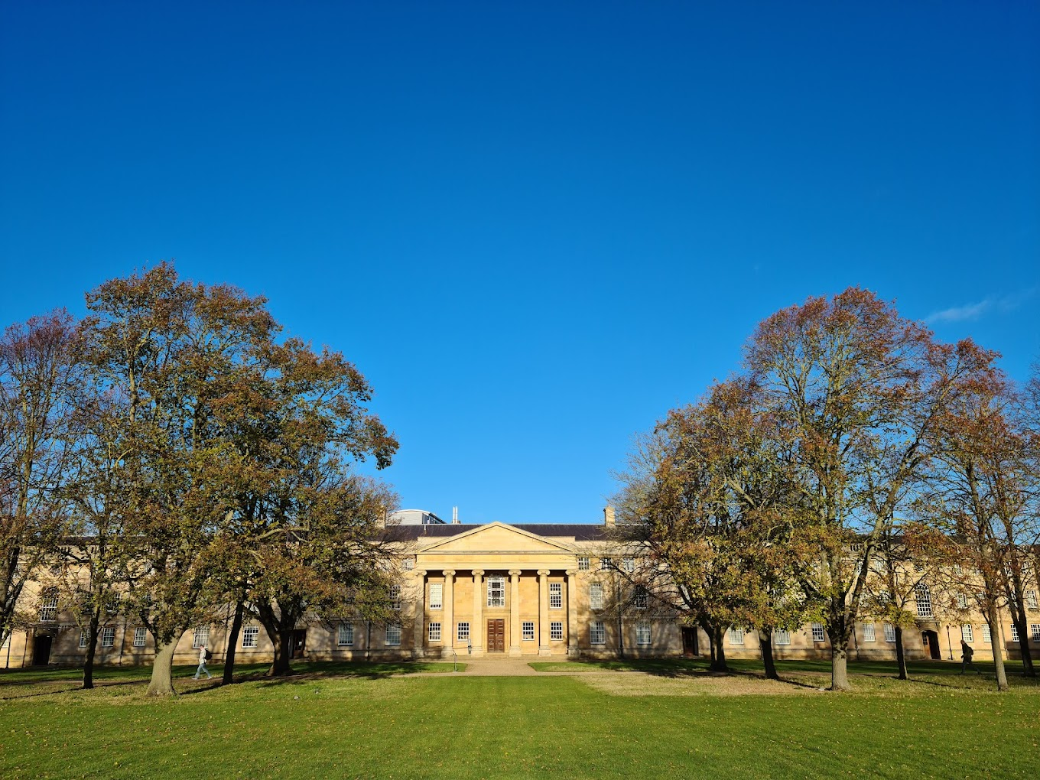
Chapel, Downing College, Cambridge

Slide 3
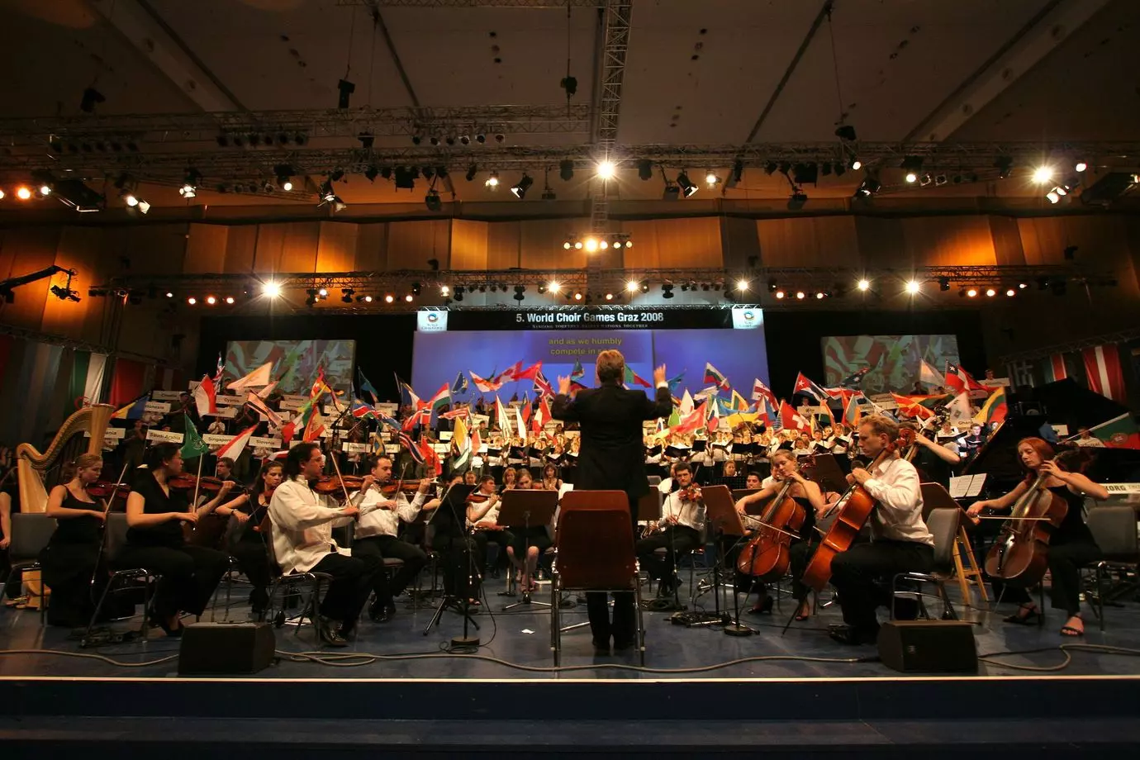
World Choir Games, Graz

Slide 4
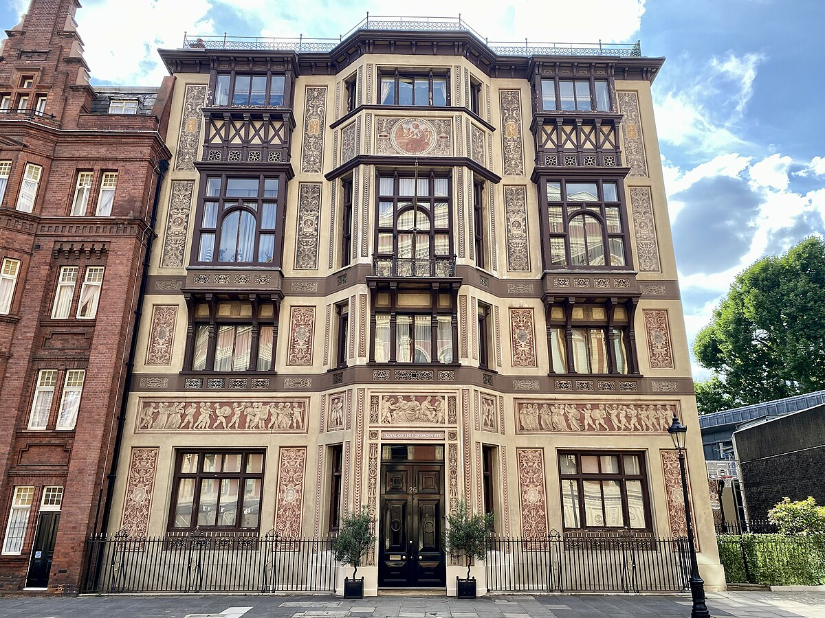
Royal College of Organists

Slide 5
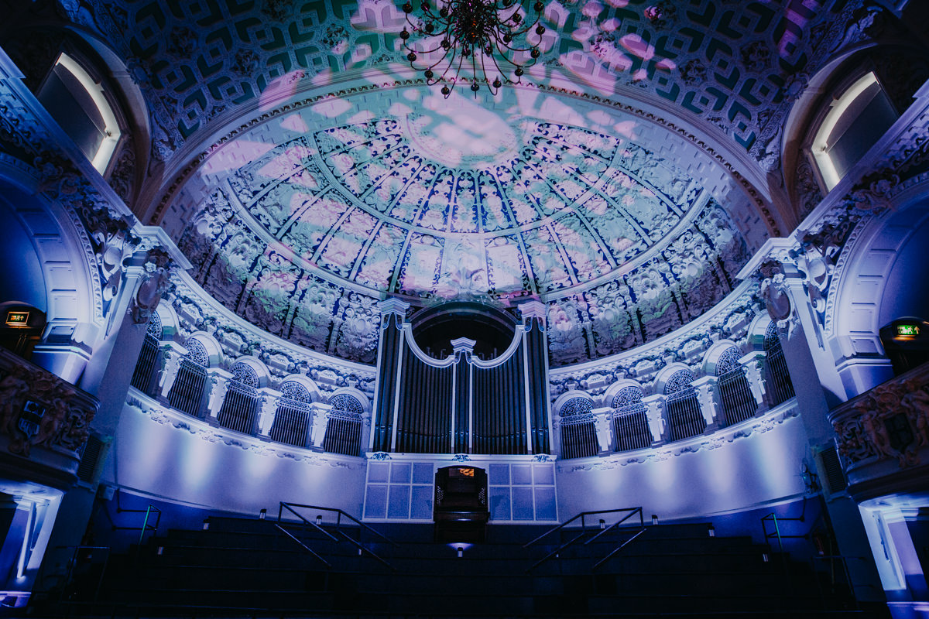
Oxford Town Hall

Slide 6
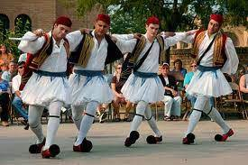
Cyprus Folk Festival

Slide 7
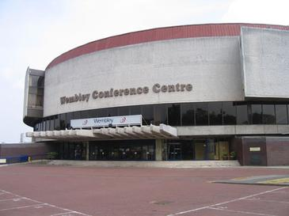
Wembley Conference Centre, London

Slide 8
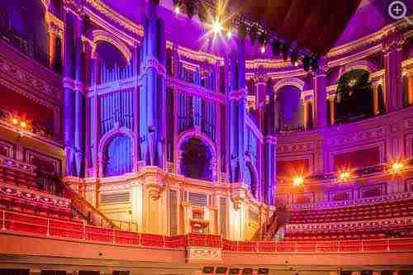
Royal Albert Hall

Slide 9
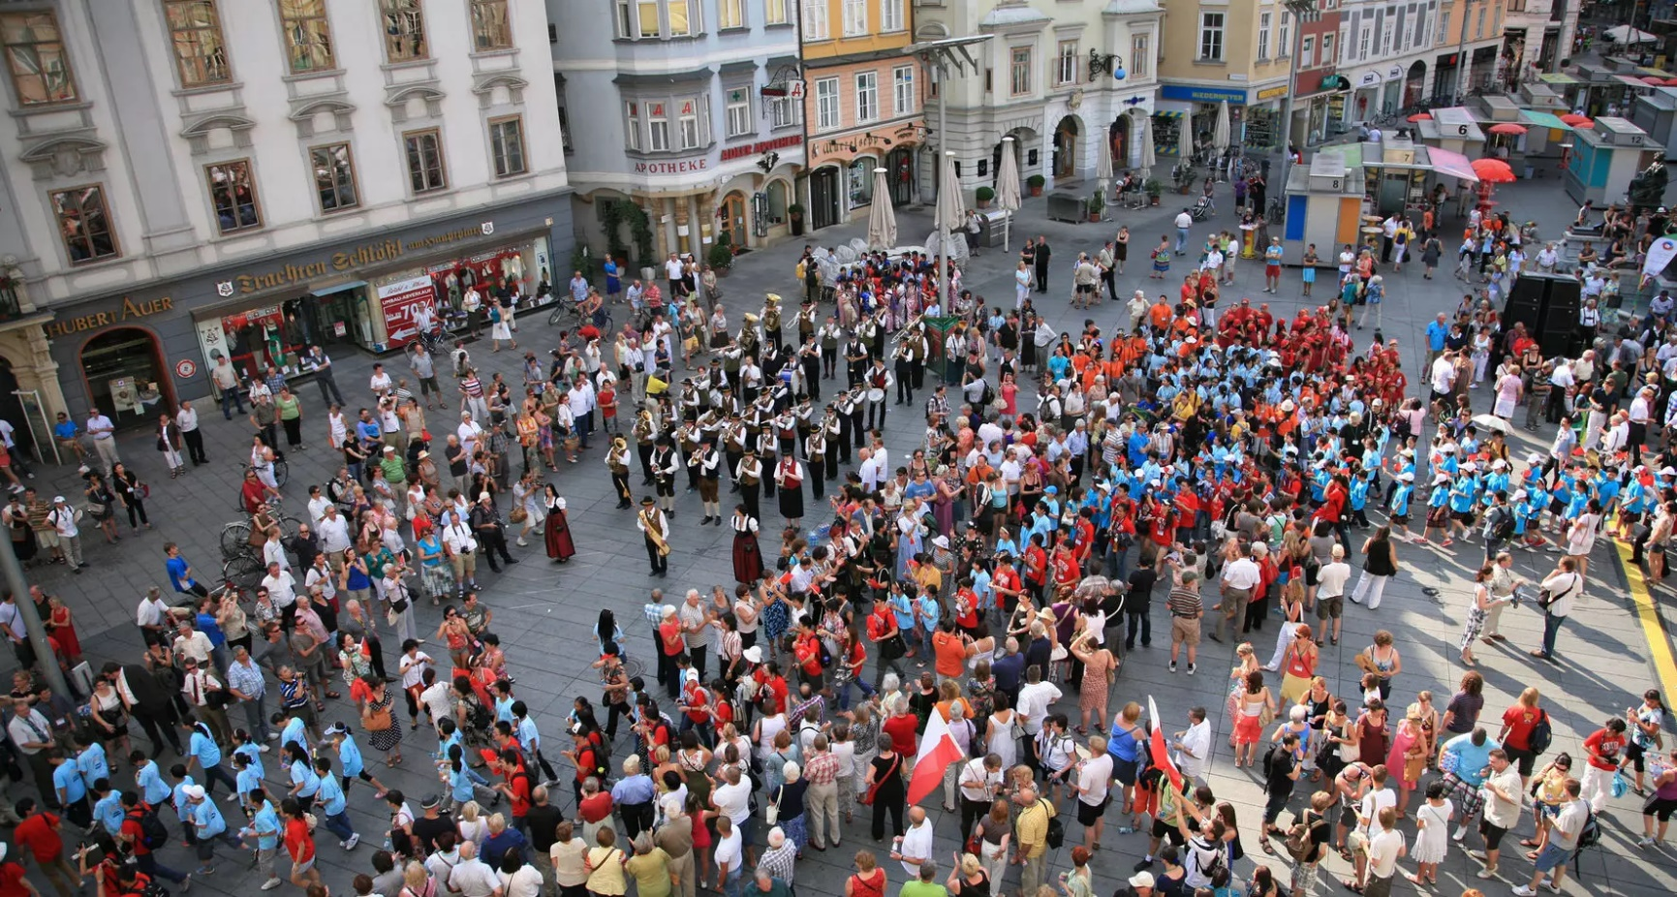
World Choir Games, Graz

Slide 10
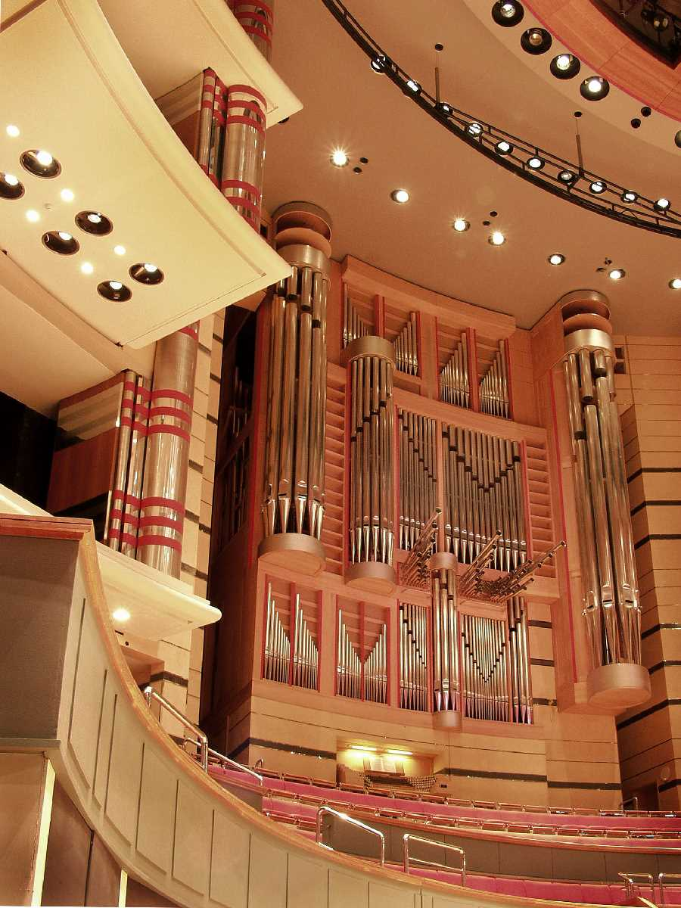
Symphony Hall, Birmingham

Slide 11
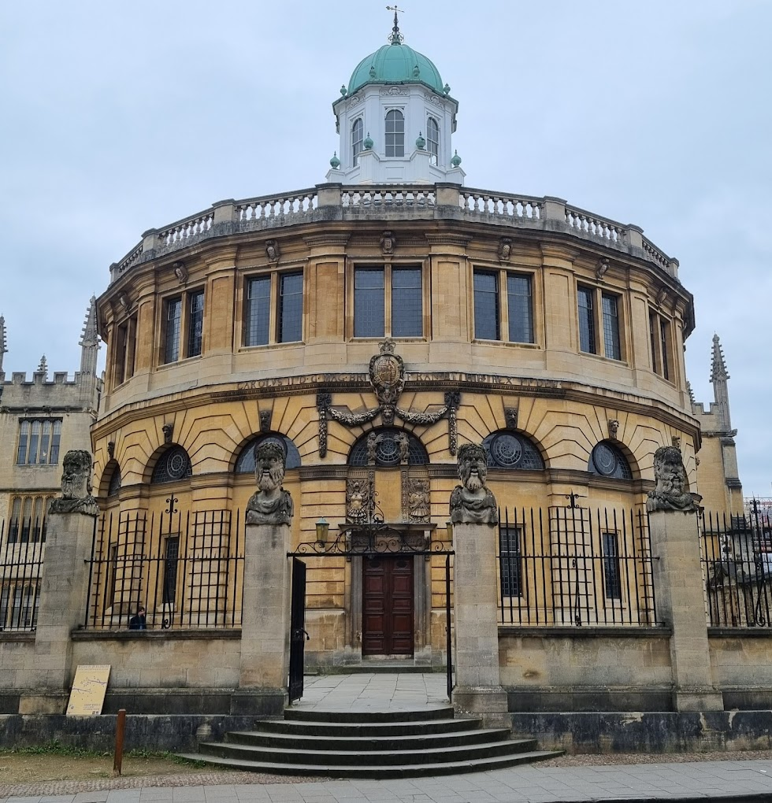
Sheldonian Theatre, Oxford

Slide 12
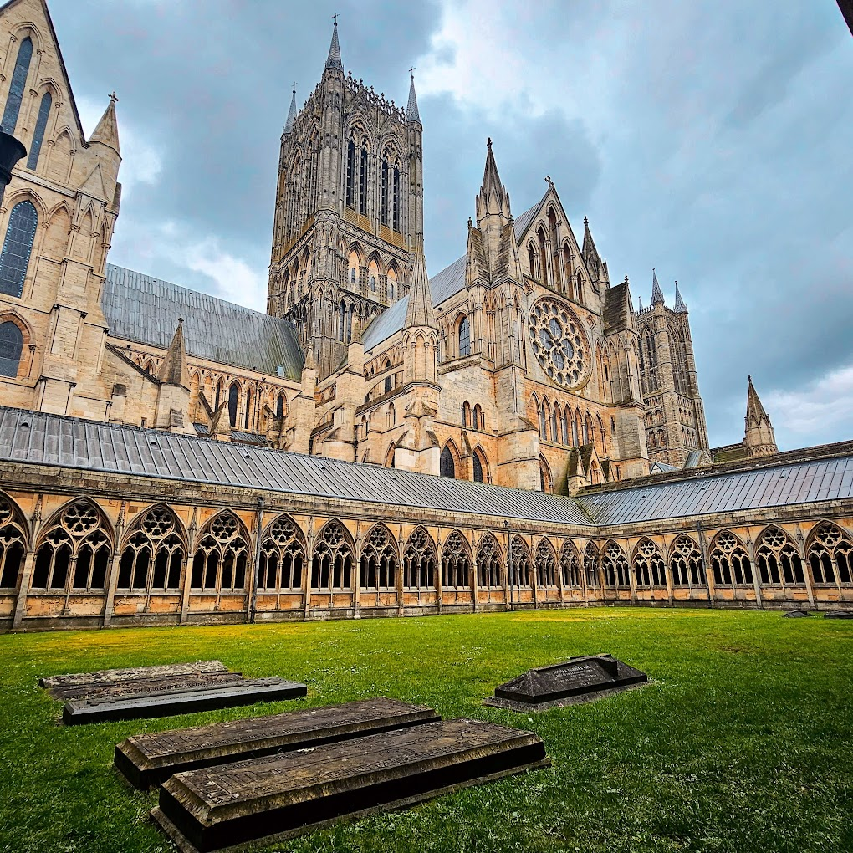
Lincoln Cathedral

Slide 13
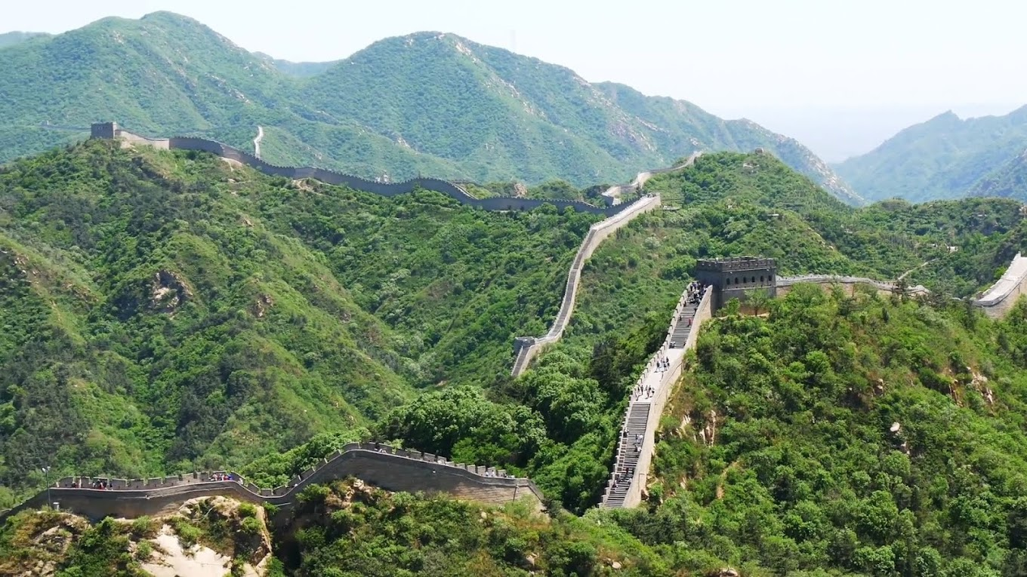
Great Wall of China

Slide 14
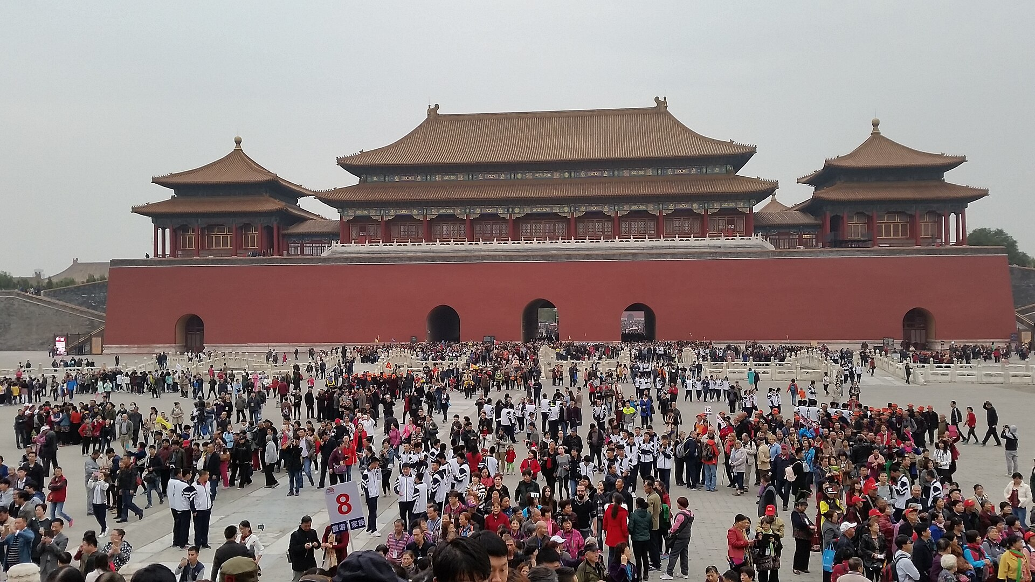
Forbidden City, Beijing

Slide 15
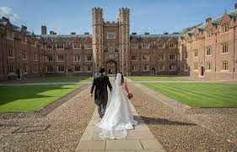
Organist for weddings

Slide 16
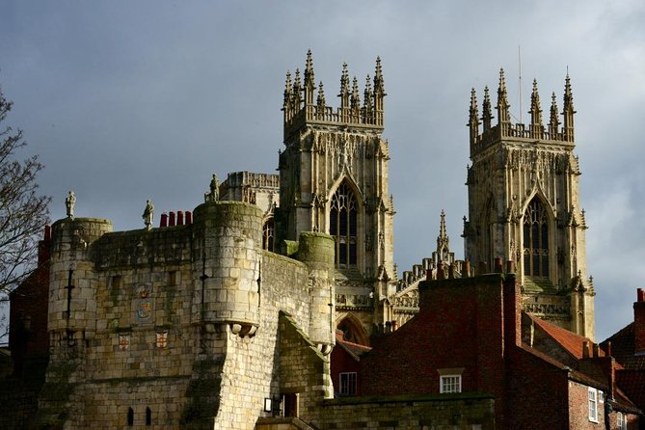
York Minster

Slide 17
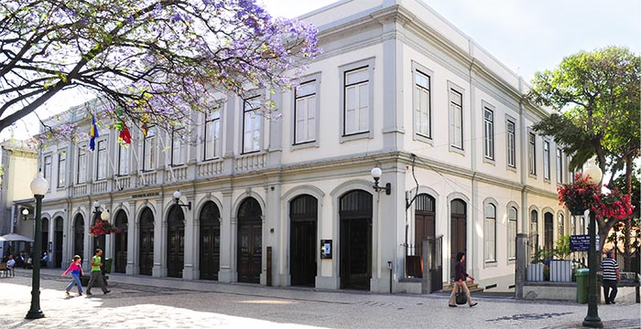
Baltazar Dias Theatre, Funchal, Madeira

Slide 18
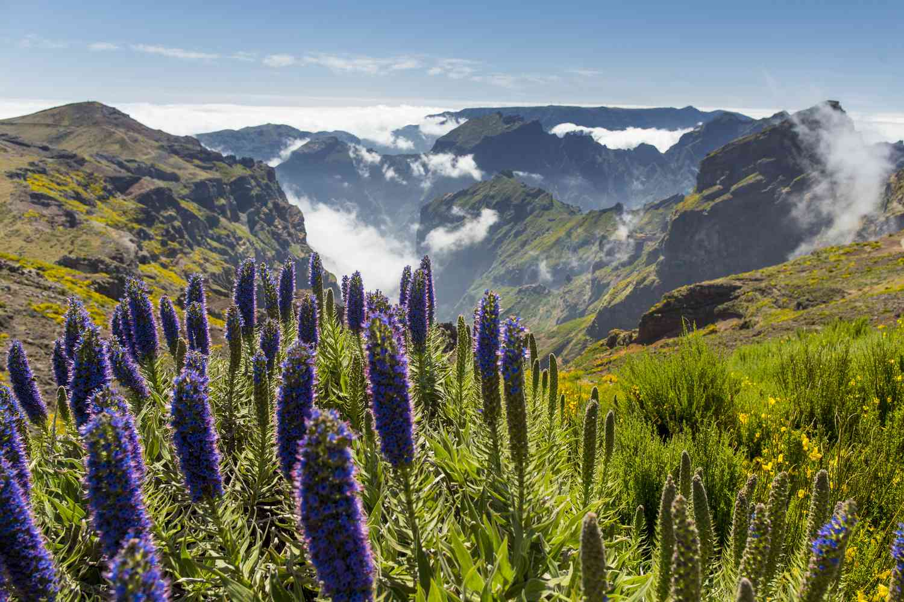
Madeira

Slide 19
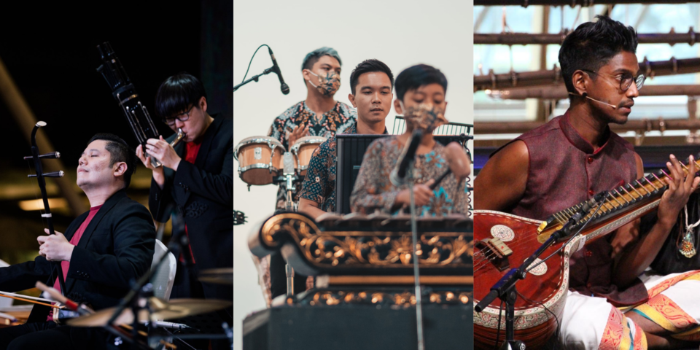
Singapore

Slide 20
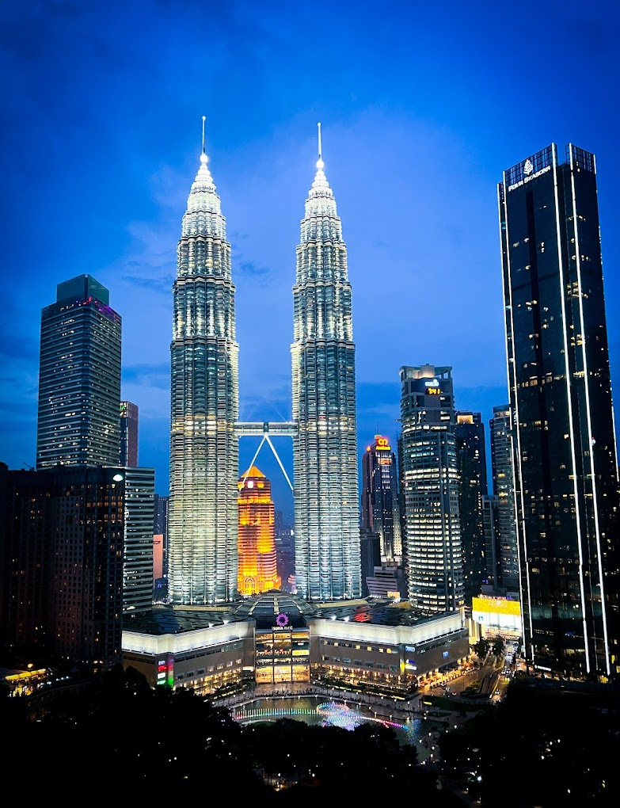
Twin Towers, Kuala Lumpur

Slide 21
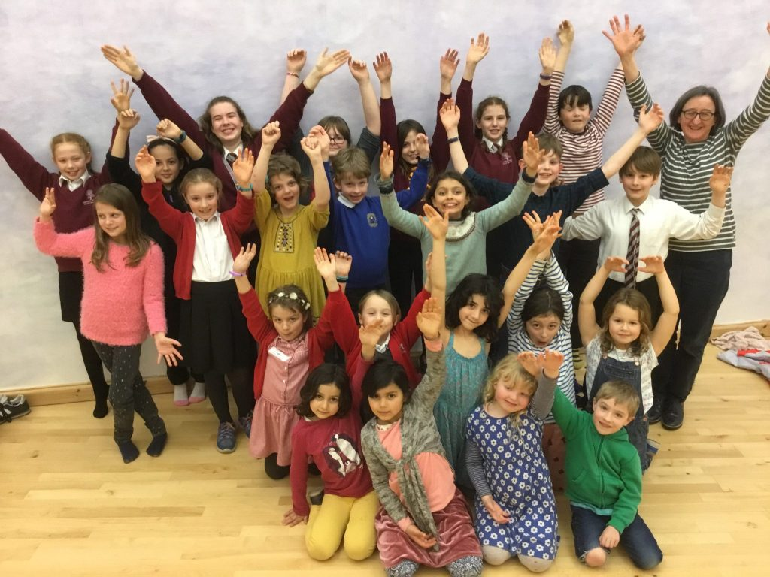
Frome Youth Choir

Slide 22
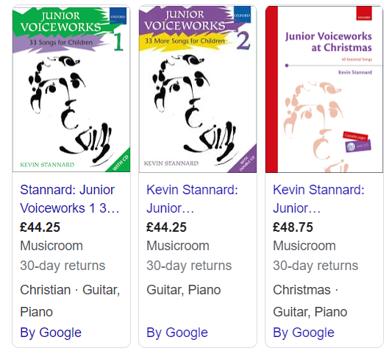
Voiceworks publications

Slide 23
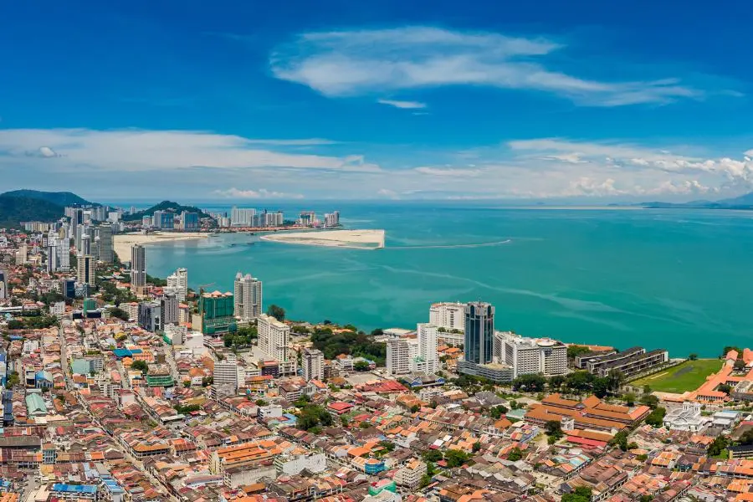
Penang

Slide 24
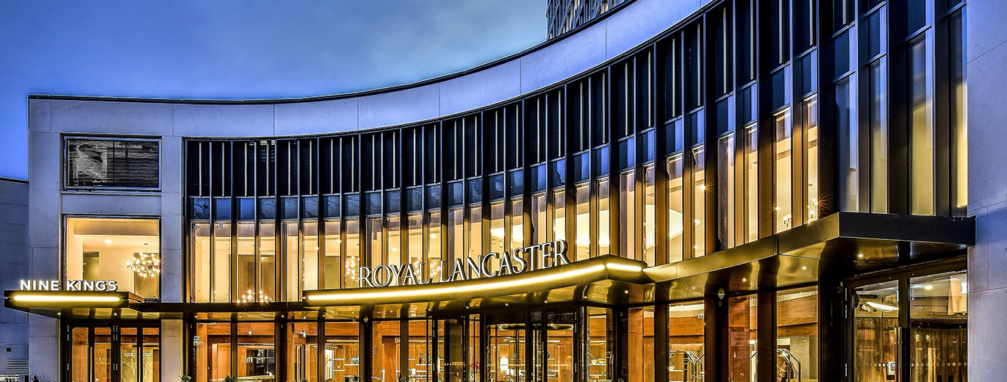
Royal Lancaster Hotel

Slide 25
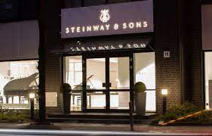
Steinway Piano Factory, Hamburg

Slide 26
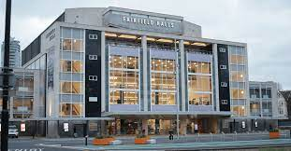
Fairfield Halls

Slide 27
Norwegian Institute for Screen and Studio

Slide 28
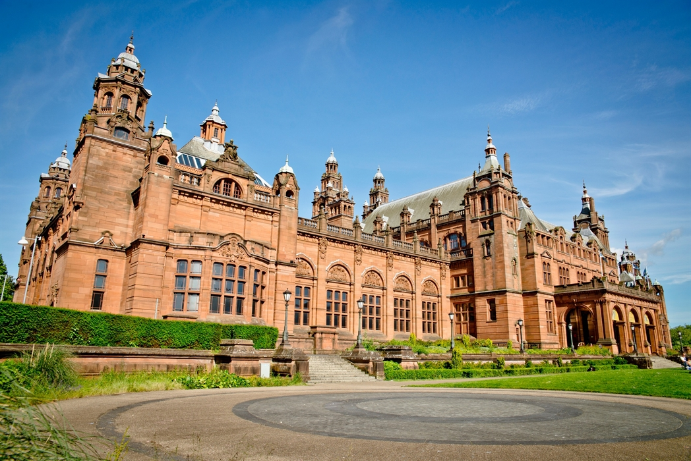
Kelvingrove Museum, Glasgow

Slide 29
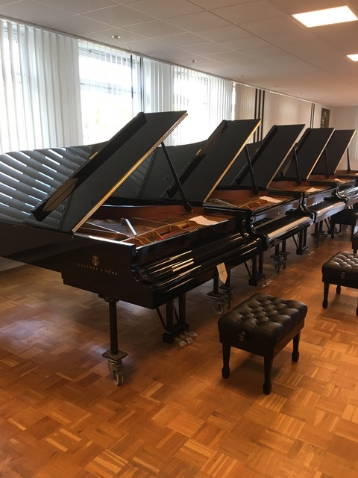
Steinway Hall, London

Slide 30
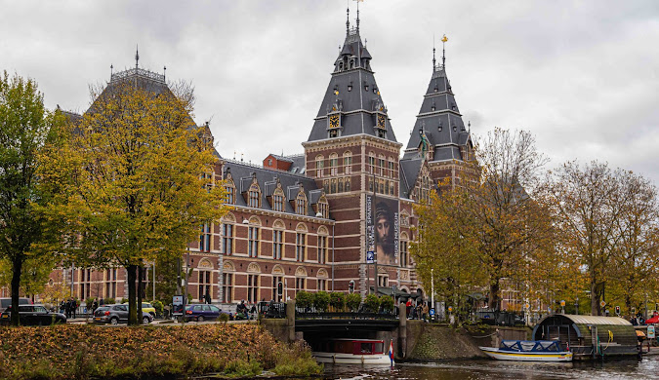
Amsterdam

Slide 31
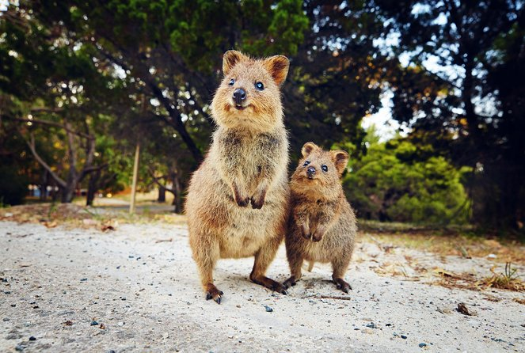
Quokkas on Rottnest Island

Slide 32
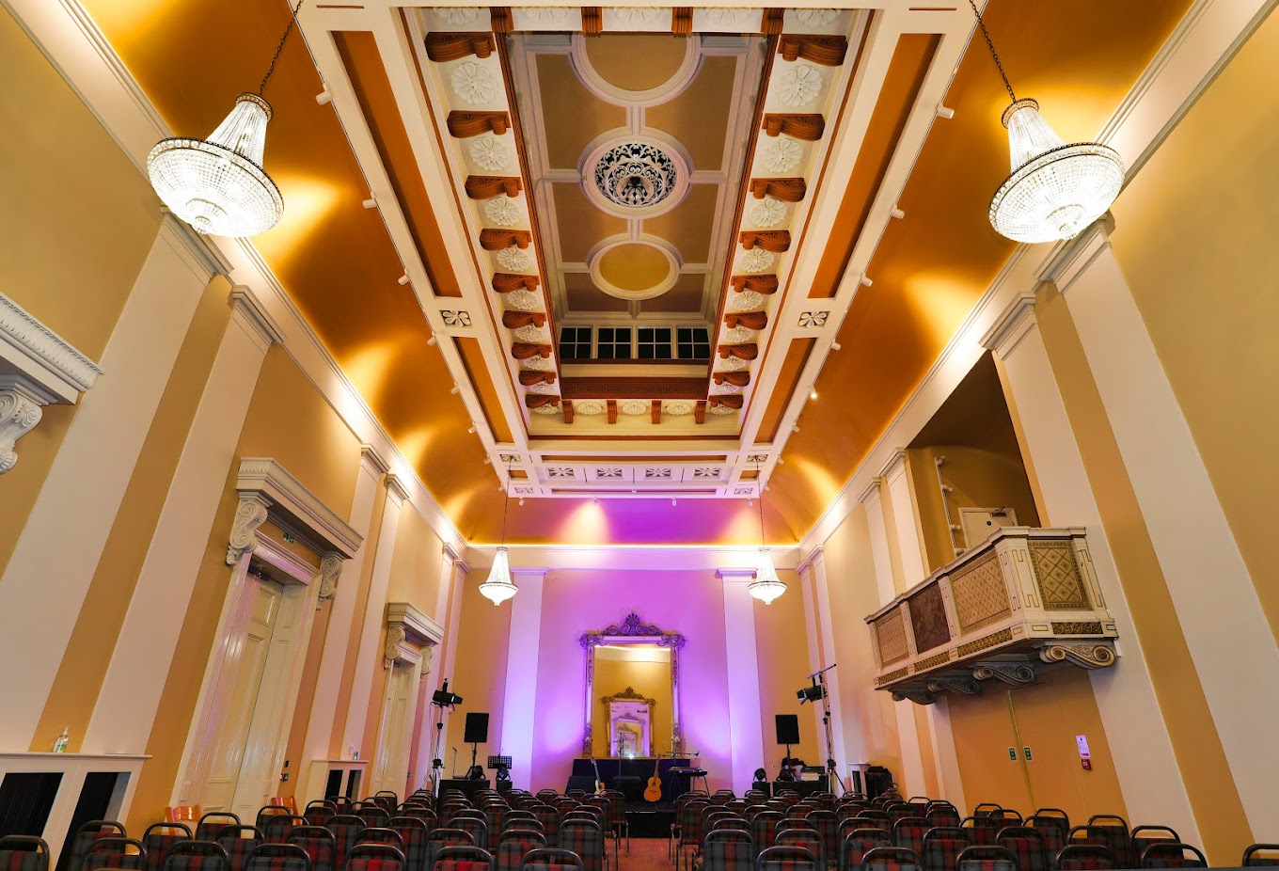
Drapers’ Hall, Coventry

Slide 33
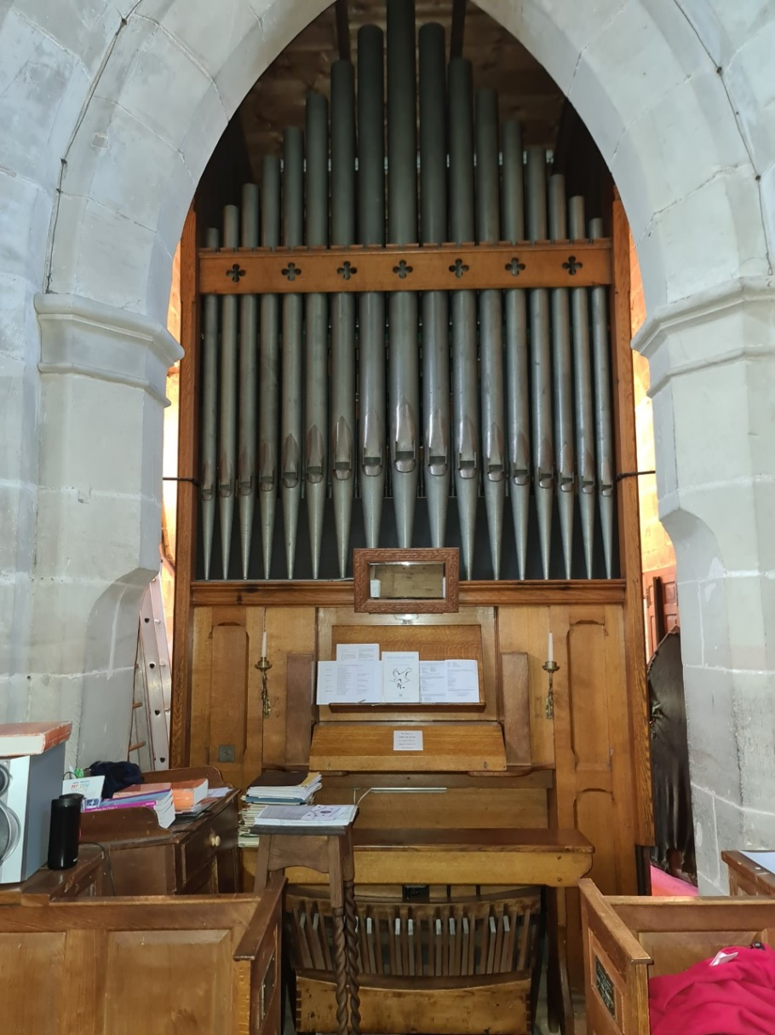
St. John the Baptist Church, Berkswell

Slide 34
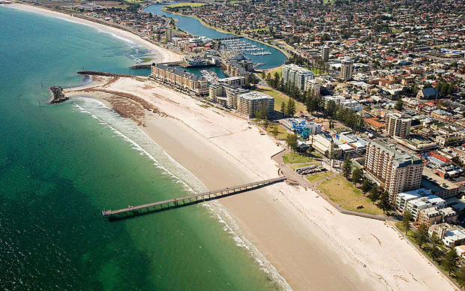
Adelaide

Slide 35
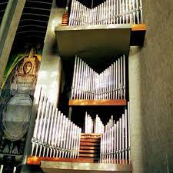
Coventry Cathedral

Slide 36
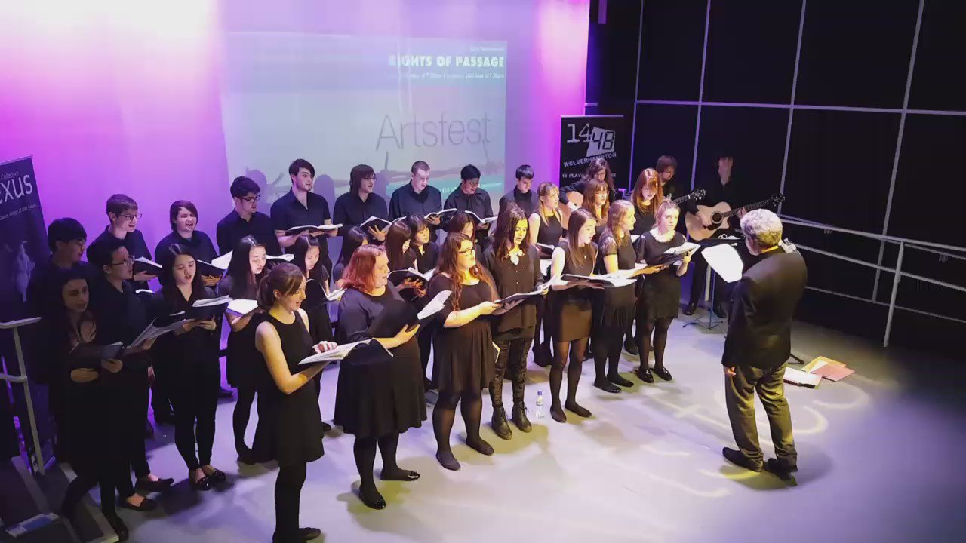
Howling Wolves, Artfest

